Slide 1




Cloud Computing Security
Presented By : Samuel & Vincent

Slide 2

1
INTRODUCTION
2
Cloud Security Models
TABLE OF CONTENT
3
Key Threats
4
Security Mechanisms
5
Algorithm Demo
6
Challenges & Future Trends
7
Conclusion & Q&A

Slide 3


INTRODUCTION
Cloud computing enables on-demand access to shared resources over the internet, but it introduces unique security challenges. Ensuring confidentiality, integrity, and availability of data stored and processed in the cloud.
Cloud is widely used for storage, computing, and business operations.
Security breaches can lead to significant financial and reputational damage.

Slide 4
Cloud Security Models
Shared Responsibility Model Cloud provider handles physical infrastructure security.
Customer handles data, applications, and user access security.
Example: AWS's shared responsibility model.
Public Cloud Open to multiple tenants.
Cost-effective but higher risks.
Private Cloud Dedicated resources for one organization.
Enhanced security and control.
Hybrid Cloud Combines public and private clouds.
Balances cost and security.

Slide 5




Key Threats in
Cloud Security
Data Breaches
Unauthorized access to sensitive information.
Example: Capital One Breach (2019) – exposed 100M+ customer records due to misconfigured firewall.
Insider Threats
Employees or contractors misusing privileges
Example: Code Spaces Attack(2014) –insider sabotage destroyed customer data.
DDoS Attacks
Overloading cloud resources to disrupt services.
Example: Targeting AWS during high-traffic events.

Slide 6

Mitigating Cloud Risks
Encryption:
Secures data at rest and in transit.
Example: AES for file encryption.
Identity and Access Management (IAM):
Role-based access control (RBAC) and Multi-Factor Authentication (MFA).
Secure Communication:
Using TLS/SSL to protect data in transit.

Slide 7

Encryption in Cloud Security
What is encryption? Transforming data into unreadable formats to unauthorized users.
Types
Symmetric Encryption (AES).
Asymmetric Encryption (RSA).
Example: Using AES for securing a customer’s financial data stored in the cloud.
01
Data at Rest
03
End to End
02
Data in Transit
04
Homomorphic

Slide 8
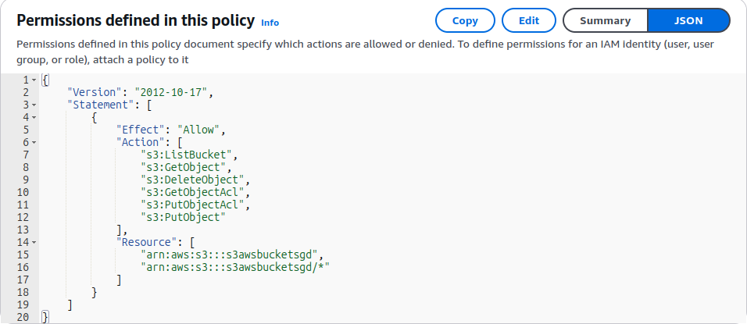
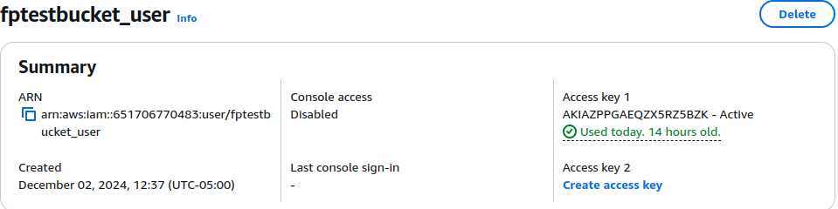
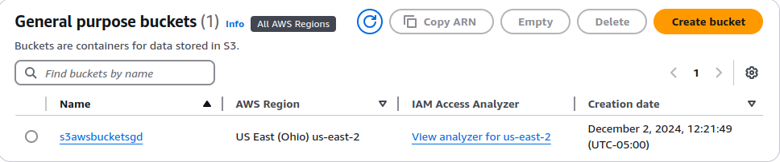
Private Cloud Model: AWS s3 creation
Access Key
Secret Access Key

Slide 9
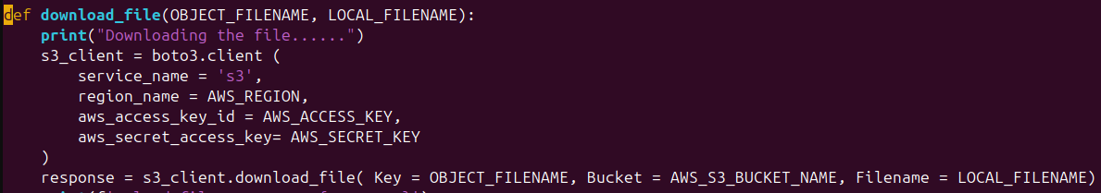
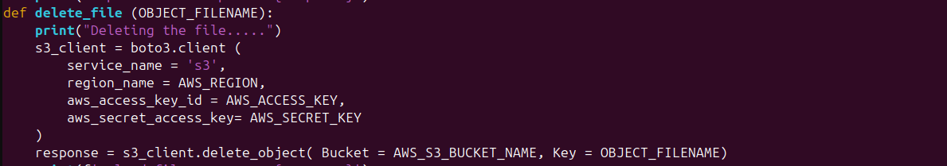
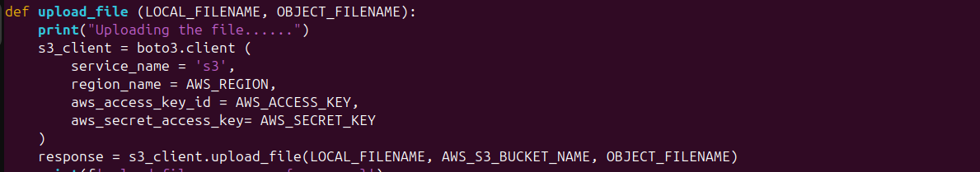
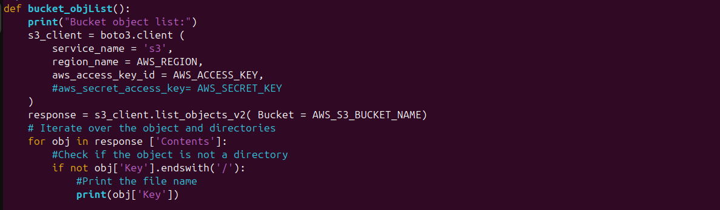

Slide 10
Code Demo

Slide 11



Challenges and Limitations
Encryption Overhead: Slower data upload/download speeds.
Insider Threats: Encryption doesn’t prevent misuse of authorized access.
Cost: Advanced security measures can increase operational costs.
Evolving Threats: Cybercriminals continually find new vulnerabilities.
Data Ownership: Who is responsible for security? Provider or customer?
ENCRYPTION
IDENTITY MANAGEMENT
COMPLIANCE

Slide 12
Future Trends in Cloud Security
AI and Machine Learning: Predict and mitigate threats in real-time. AI and machine learning are increasingly used to monitor and detect abnormal behaviors in cloud environments.
Quantum-Safe Cryptography: Protecting against quantum computing threats. Developing encryption algorithms resistant to quantum computing attacks.
Zero-Trust Architecture: Moving beyond perimeter-based security to a “never trust, always verify” model.
Edge Computing Security: Securing data processed closer to users.

Slide 13
Everyday Cloud Examples
File Storage and Sharing
Google Drive
Offers free and paid plans for storing and sharing files.
Dropbox
Popular for sharing large files easily.
Microsoft OneDrive
Built into Windows and Office 365, for seamless productivity.
Media Streaming
Netflix
Uses the cloud to store and deliver movies and TV shows.
Spotify
Streams millions of songs, podcasts, and playlists directly from the cloud.
YouTube
Relies on Google Cloud to host and stream videos globally.
Social Media Platforms
Facebook
Stores user data, posts, and photos on cloud infrastructure.
Instagram
Cloud services power image hosting and live streaming.
TikTok
Relies on cloud services for video storage and recommendation algorithms.
Email Services
Gmail
Google’s email service operates entirely in the cloud.
Outlook
Microsoft’s cloud based email platform integrates with OneDrive.
Yahoo Mail
A longstanding cloud-based email service.
Cloud Storage
Apple iCloud
Automatically backs up photos, videos, and device data.
Google Photos
Provides cloud-based photo storage and organization.
Amazon Photos
Offers secure storage for personal photos and videos.
Gaming
Xbox Cloud Gaming
Allows players stream games without downloading.
NVIDIA GeForce Now
Enables high-performance gaming using cloud hardware.

Slide 14
Cloud computing offers flexibility but introduces unique security challenges.
Encryption, and secure protocols are critical for mitigating risks.
The future of cloud security lies in AI, Zero Trust, and quantum safe solutions.
Vigilance and continuous improvement are essential to staying ahead of threats.
Key
Takeaways

Slide 15
THANK YOU

Slide 16
References
Acar, T., Belenkiy, M., and Goldwasser, S. “Efficient Techniques for Secure Cloud Computing.” IEEE Xplore, 2019, https://ieeexplore.ieee.org.
Amazon Web Services. “Shared Responsibility Model.” Amazon Web Services, https://aws.amazon.com/compliance/shared-responsibility-model. Accessed 25 Nov. 2024.
IBM Security. Cost of a Data Breach Report. IBM, 2023, https://www.ibm.com/security/data-breach.
Microsoft Azure. “What Is Cloud Security?” Microsoft Azure, https://azure.microsoft.com. Accessed 25 Nov. 2024.
National Institute of Standards and Technology (NIST). Special Publication 800-144: Guidelines on Security and Privacy in Public Cloud Computing. NIST, 2011, https://nvlpubs.nist.gov.
Rittinghouse, John W., and James F. Ransome. Cloud Computing: Implementation, Management, and Security. CRC Press, 2017.
Stallings, William. Network Security Essentials: Applications and Standards. 6th ed., Pearson, 2017.
Takabi, Hassan, et al. “Security and Privacy Challenges in Cloud Computing Environments.” IEEE Security & Privacy, vol. 8, no. 6, 2010, pp. 24–31.
Verizon. Data Breach Investigations Report (DBIR). Verizon, 2023, https://www.verizon.com/business/resources/reports/dbir.

